Slide 1
Introduction to Network Time Protocol (NTP)
Version A.01
H3065S Module 15 Slides

Slide 2

Introduction to the Network Time Protocol (NTP)
Time synchronization determines consistency of:
- NFS time stamps
- encryption key expiration times
- time stamps used by incremental backups, programmer’s make files, and applications
HP-UX uses NTP to maintain time synchronization:
without NTP
with NTP
NTP Server
NTP Client
NTP Client
a673162

Slide 3
NTP Time Sources
NTP time sources can include:
radio clocks using signals from GPS satellites
(~cost $1000, most accurate)
network time sources on the Internet
(free, but less accurate)
built-in system clock
(free, but least accurate)
a673163

Slide 4

NTP Stratum Levels
Accuracy of a time source is defined by its stratum level:
Stratum = 1 Most accurate
Stratum = 15 Least accurate
S1
System with locally attached radio clock
S2
System getting time from an S1 NTP server
S3
System getting time from an S2 NTP server
a673164

Slide 5
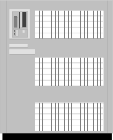
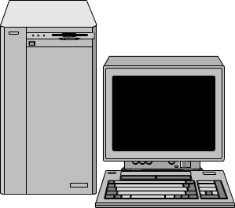
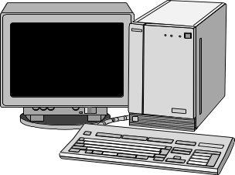
NTP Roles
Renay
Stratum 1
Server
Sohrab
Stratum 1
Server
Frank
Stratum 1
Server
Gary
Stratum 1
Server
Brian
S2
Larry
Stratum 1
Server
John
S2
Darren
S2
Don
Stratum 1
Server
Peer
Peer
What is the
correct time ?
Broadcast Client
Direct Polling Client
Broadcast Client
a673165

Slide 6
Defining NTP Roles via /etc/ntp.conf
The /etc/ntp.conf file defines a system’s NTP role on the network.
Entry to define a server with a radio clock (Frank from diagram, previous slide):
Entry to define a stratum 2 time source (John from diagram, previous slide):
# vi /etc/ntp.conf
server 127.127.4.1
peer Larry
# vi /etc/ntp.conf
server Larry
server Frank
peer Brian
peer Darren
broadcast 128.1.255.255
driftfile /etc/ntp.drift
a673166

Slide 7
More /etc/ntp.conf Examples
Entry to define a time server that uses its own internal clock:
# vi /etc/ntp.conf
server 127.127.1.1
fudge 127.127.1.1 stratum 10
Entry to define a client using direct server polling:
# vi /etc/ntp.conf
server brian
driftfile /etc/ntp.drift
Entry to define a client using broadcast:
# vi /etc/ntp.conf
broadcastclient yes
driftfile /etc/ntp.drift
a673167

Slide 8
How NTP Adjusts the System Clock
/usr/sbin/ntpdate
utility called once at system boot
polls one or more NTP servers
synchronizes local clock to most accurate NTP server
/usr/sbin/xntpd
daemon started at system boot
polls one or more NTP servers at regular intervals
synchronizes local clock to most accurate NTP server
/etc/ntp.drift
file maintained by xntpd
tracks the local clock’s accuracy over time
a673168

Slide 9
Configuring an NTP Server
Step-by-step procedure for configuring an NTP server:
1. Modify the /etc/rc.config.d/netdaemons file.
2. Modify the /etc/TIMEZONE file as appropriate.
3. Modify /etc/ntp.conf as described previously.
4. Run the /sbin/init.d/xntpd startup script.
5. Wait! NTP requires several polling intervals (up to 6 minutes) to
establish associations with its peers and servers. Be patient.
6. Run ntpq -p to check associations.
export NTPDATE_SERVER=
export XNTPD=1
export XNTPD_ARGS=
TZ=CST6CDT
export TZ
a673169

Slide 10
Configuring an NTP Client
Step-by-step procedure for configuring an NTP client:
1. Modify the /etc/rc.config.d/netdaemons file on all clients and servers.
2. Modify the /etc/TIMEZONE file as appropriate on all clients and servers.
3. Modify /etc/ntp.conf as described previously.
4. Run the /sbin/init.d/xntpd startup script.
5. Wait! NTP requires several polling intervals (up to 6 minutes) to
establish associations with its peers and servers. Be patient.
6. Run ntpq -p to check associations.
export NTPDATE_SERVER=’server1 server2’
export XNTPD=1
export XNTPD_ARGS=
TZ=CST6CDT
export TZ
a69813

Slide 11
Verifying NTP Functionality
View NTP activity and errors over time:
Ensure xntpd daemon is running:
View association with other nodes:
# more /var/adm/syslog/syslog.log
# ps -ef | grep xntpd
# ntpq -p
remote refid st when poll reach delay offset disp
--------------------------------------------------------------
*John Larry 3 64 64 377 0.87 10.56 16.11
+Brian Renay 3 100 264 376 9.89 5.94 16.40
Darren 0.0.0.0 16 - 64 0 0.00 0.00 1600.00
a673171

